Slide 1
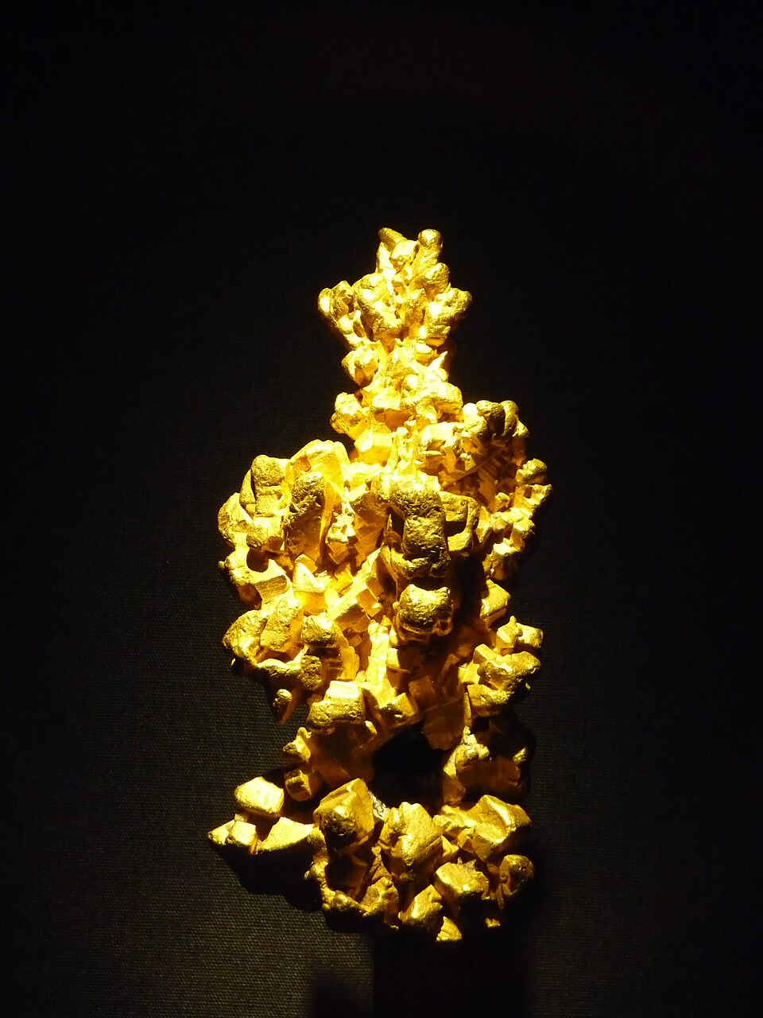

AI Nugget:
Human vs. AI Feedback on Writing
Heather Kretschmer (ZESS)
By I, Gump Stump, CC BY-SA 3.0, https://commons.wikimedia.org/w/index.php?curid=5866917
Notes:
Photo: https://commons.wikimedia.org/wiki/File:Latrobe_gold_nugget_Natural_History_Museum.jpg

Slide 2
Learning Objectives
Think critically about feedback on writing
Compare feedback from a human and from AI
Reflect on the kind(s) of feedback you’ll find valuable in future writing projects
By I, Gump Stump, CC BY-SA 3.0, https://commons.wikimedia.org/w/index.php?curid=5866917
Notes:
Photo: https://commons.wikimedia.org/wiki/File:Latrobe_gold_nugget_Natural_History_Museum.jpg

Slide 3

Procedure
Find a study buddy.
Decide what language the two of you will write in.
Individually, write a short text without AI.
  Topic you both are familiar with and able to write on
  Sample writing prompts later in the video
Notes:
images: https://www.pexels.com/de-de/foto/mann-und-frau-sitzen-am-tisch-mit-laptop-computer-5965699/
https://www.pexels.com/de-de/foto/mann-und-frau-sitzen-auf-bank-mit-laptop-computer-5965673/

Slide 4

Procedure
Exchange texts to read and give each other feedback on writing:
  What is one thing you liked about the text? Be specific.
  Was there anything in the text that was confusing or hard to understand?
  What would you change to make the text even better?
Individually, think critically about the feedback you received.
Notes:
images: https://www.pexels.com/de-de/foto/mann-und-frau-sitzen-am-tisch-mit-laptop-computer-5965699/
https://www.pexels.com/de-de/foto/mann-und-frau-sitzen-auf-bank-mit-laptop-computer-5965673/

Slide 5
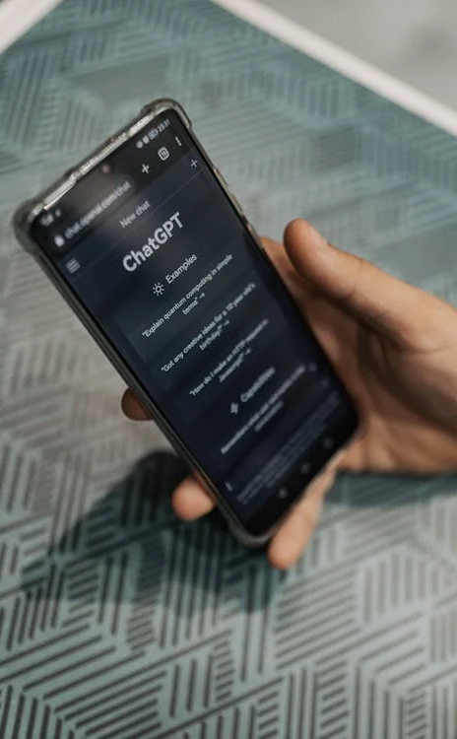
Procedure
5. Individually, enter your original texts into our university’s ChatAI. Prompt the AI step by step:
Only correct the grammar in this text.
Do not make any other changes.
Only make word choice suggestions in this text. Do not make any other changes.
Only correct the punctuation in this text.
Do not make any other changes.
Notes:
image: https://www.pexels.com/de-de/foto/mann-hand-smartphone-internet-16094052/

Slide 6

Procedure
Individually:
6. Think critically about the AI’s output:
  Does the text make sense?
  Are there mistakes in the AI text?
  Did the AI do what you asked it to do?
7. Consider which suggestions for improvement from your study buddy and AI you want to take. Revise your original text.
Notes:
image: https://www.pexels.com/de-de/foto/mann-und-frau-sitzen-am-tisch-mit-laptop-computer-5965685/

Slide 7
Procedure
8. Together, share your revised texts and discuss your takeaways from working through the procedure:
  What kind(s) of feedback was useful from each source (human and AI)?
  What other feedback might you ask from each source?
  How skilled are you as writers in the language? Are you native speakers or language learners? How might your language proficiency have affected your ability to use the feedback effectively?
  What step(s) from this procedure will you try out again in another writing project?
9. Suggestion: Try the entire procedure again
in a different language.
Notes:
https://www.pexels.com/de-de/foto/mann-und-frau-sitzen-auf-bank-mit-laptop-computer-5965673/

Slide 8

Sample Writing Prompts
Choose one of the following prompts. Respond to it in one paragraph.
Describe a time when your curiosity led you to learn something unexpected. What did you discover?
Describe a recent challenge you faced in your studies. What did you learn about yourself through that experience?
If you could redesign one course you’ve taken, what would you change and why?
Notes:
Image: https://www.pexels.com/de-de/foto/schwarzer-mann-mit-tastatur-des-laptops-5792873/

Slide 9
AI Nugget:
Human vs. AI Feedback on Writing
Heather Kretschmer (ZESS)
By I, Gump Stump, CC BY-SA 3.0, https://commons.wikimedia.org/w/index.php?curid=5866917
Notes:
Photo: https://commons.wikimedia.org/wiki/File:Latrobe_gold_nugget_Natural_History_Museum.jpg

